Slide 1
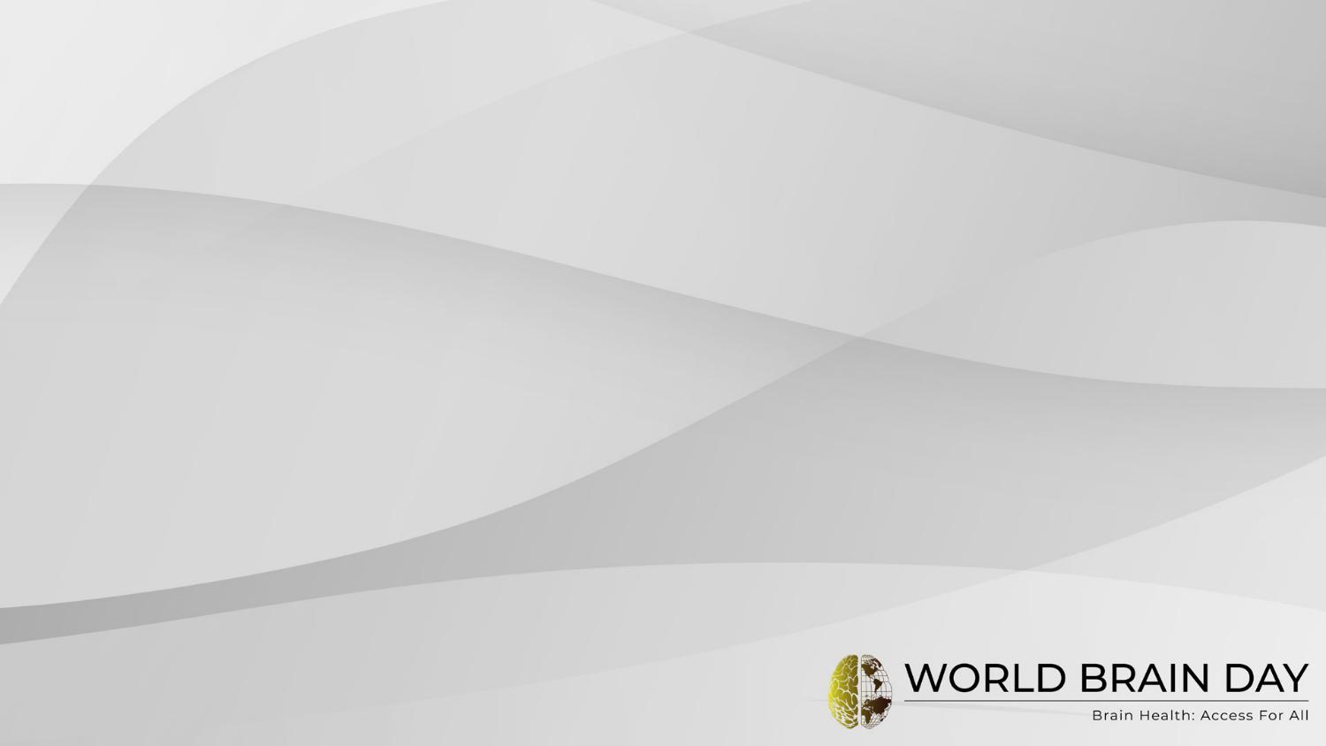
World Brain Day 2026
WORLD FEDERATION OF NEUROLOGY
World Brain Day 2026
Brain Health: Access for All

Slide 2
Core Campaign Message
World Brain Day 2026 brings together the global community across all six World Federation of Neurology regions:
Africa
Asia–Oceania
Eastern Mediterranean
Europe
Pan America
Pan Arab Region
On 22 July 2026, patients, healthcare professionals, researchers, policymakers, caregivers, and communities worldwide will unite to promote better access to brain health for everyone, everywhere.
Aligned with WHO-IGAP and Sustainable Development Goal 3 (SDG-3), World Brain Day 2026 highlights the power of global collaboration and shared action.
Learn more:
wfneurology.org/worldbrainday

Slide 3
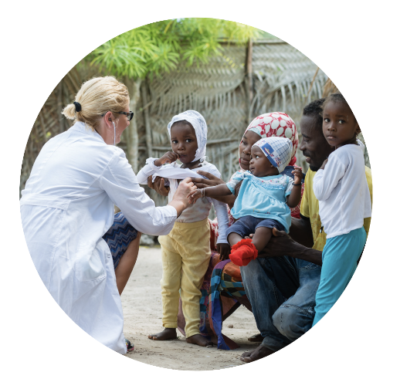
Tagline
Brain Health : Access for All

Slide 4
Tagline
Brain Health And Access to All

Slide 5
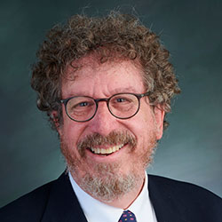
World Brain Day Leadership
“Investing in brain health means investing in people. It helps individuals reach their potential and supports healthier, more resilient societies’
Prof. Steven Lewis , President of
the World Federation of Neurology

Slide 6
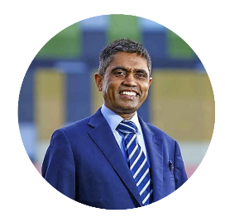

World Brain Day Leadership
World Brain Day 2026 focuses on one of the defining challenges of our time: making brain health accessible to everyone, everywhere
The message is simple but urgent: access delayed is potentially access denied.
Professor Tissa Wijeratne, OAM, MD, PhD, Chair of World Brain Day 2026.
Evidence shows that addressing lifestyle and modifiable risk factors can optimise brain health, meaning prevention, public empowerment, and stronger local policy and resources can make a meaningful difference everywhere.
Professor David Dodick, MD, Co-Chair of World Brain Day 2026.

Slide 7
Why World Brain Day 2026 Matters
A simple message:
Brain disorders are now the leading cause of disability worldwide
Over 3.4 billion people live with neurological condition
Millions still cannot access the care they need
Access to brain health remains unequal across the world
Notes:
-Mention all age groups
-brain health is a lifelong commitment to….
A healthy brain shapes how we learn, adapt, and connect with others at every stage of life. By caring for our brains —whether we're young or old—we stay sharp, resilient, and independent. Healthy brains mean better lives for everyone., across all ages”
Awareness:
Never too young, never too old…

Slide 8
Brain Health: Access For All
A simple message:
Everyone deserves access to brain healthcare
Earlier access changes lives
Prevention matters
No brain should be left behind
Notes:
-Mention all age groups
-brain health is a lifelong commitment to….
A healthy brain shapes how we learn, adapt, and connect with others at every stage of life. By caring for our brains —whether we're young or old—we stay sharp, resilient, and independent. Healthy brains mean better lives for everyone., across all ages”
Awareness:
Never too young, never too old…

Slide 9
The Global Challenge
Many people still face:
long waiting times
Shortages of neurologists
High healthcare costs
Stigma and misunderstanding
The rural and remote access barriers
Language and cultural barriers

Slide 10
Key Global Statistics
3.4 billion people affected globally
Eleven million deaths each year from neurological disorders
81% of neurological deaths occur in low and middle-income countries
In some regions there are fewer than one neurologist per million people

