Slide 1
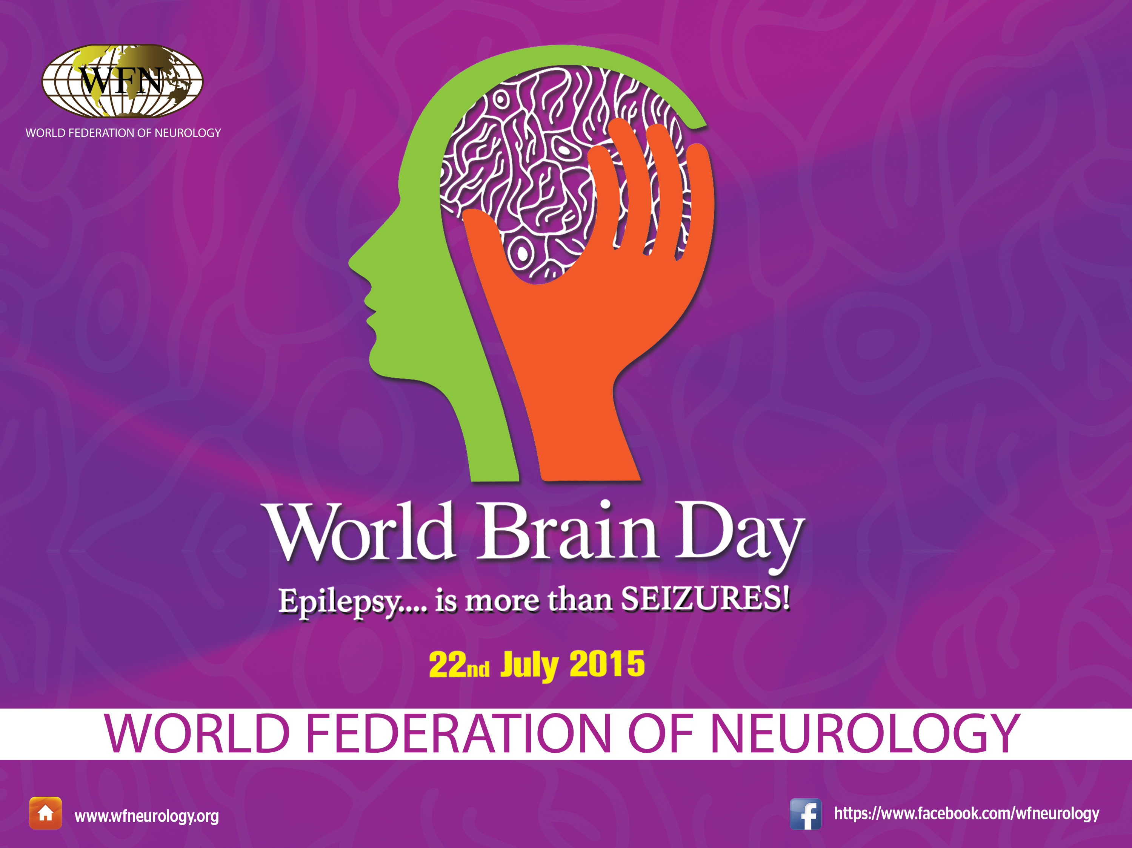

Slide 2
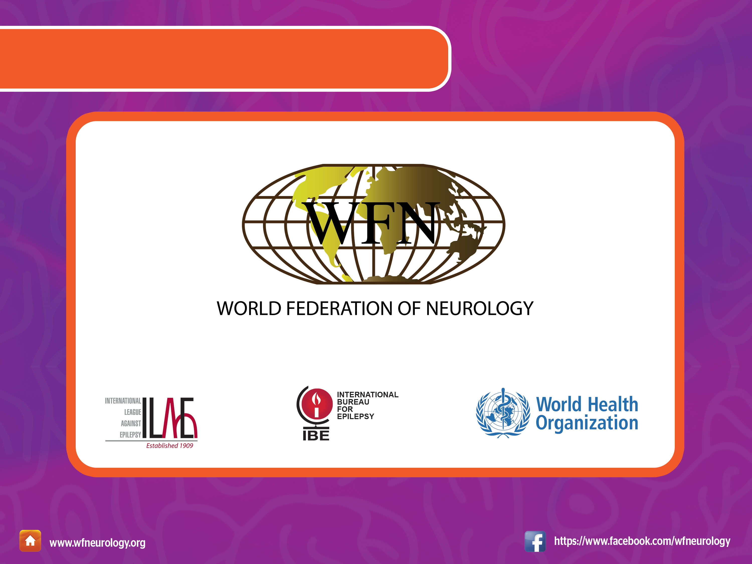
World Brain Day 2015 Partners

Slide 3
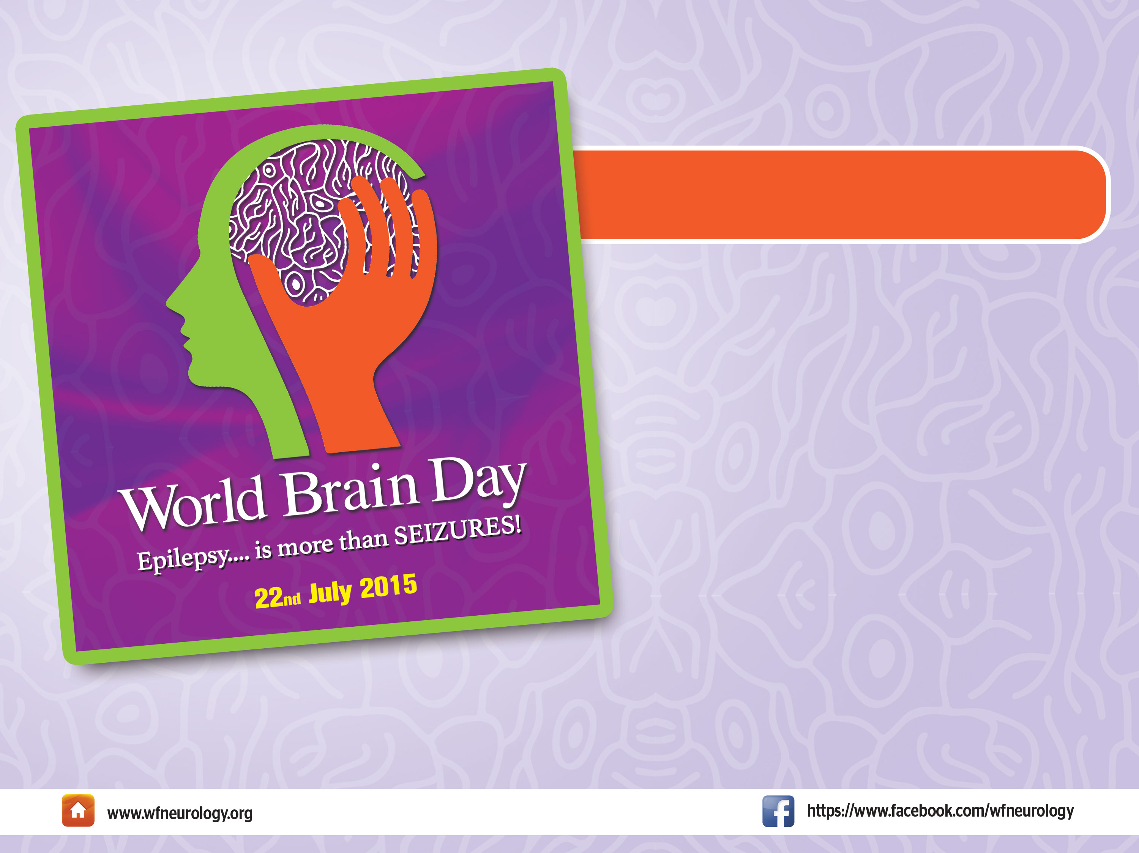
Overview WBD 2015
The World Federation of Neurology and its partners
the International League
Against Epilepsy (ILAE) and
the International Bureau for Epilepsy (IBE) together with
the World Health Organization (WHO) are pleased to
announce that the focus for this year’s World Brain Day
is epilepsy.

Slide 4

Why Epilepsy?
Epilepsy was chosen for several
reasons:
Most common of the chronic serious
brain diseases.
Lack of awareness among public &
misperceptions.
Enormous psychosocial consequences
for most people who have epilepsy.
Inadequate knowledge among
physicians.
Poor availability of medications in most
countries.

Slide 5
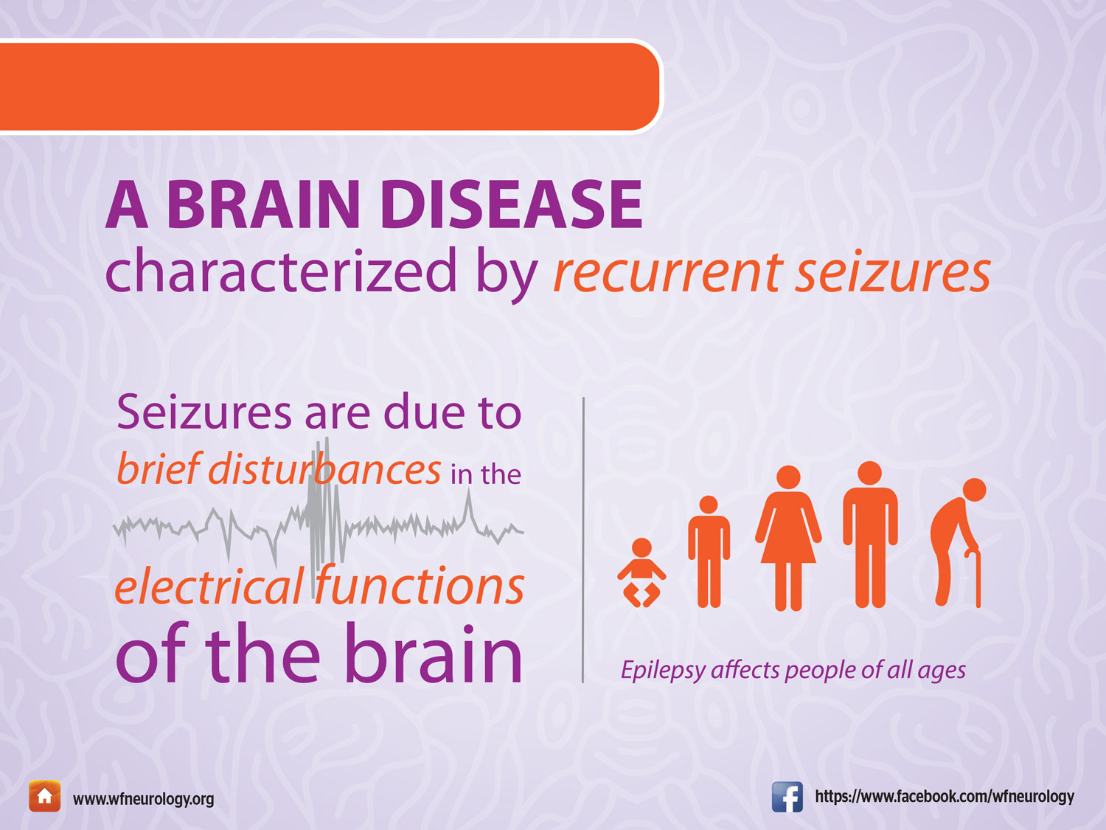
What is Epilepsy?

Slide 6
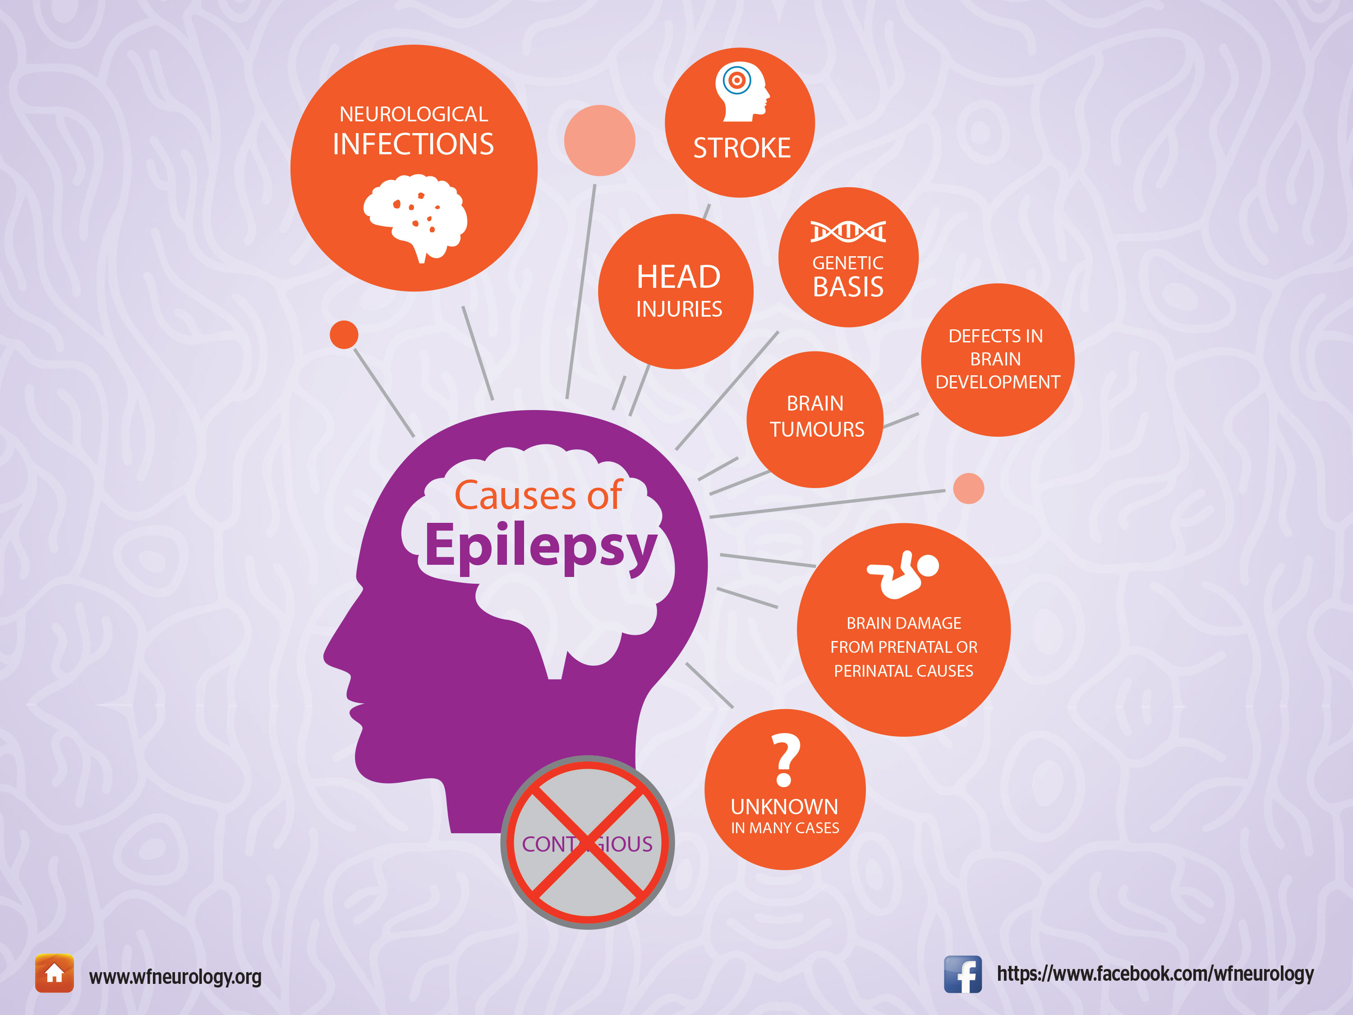

Slide 7
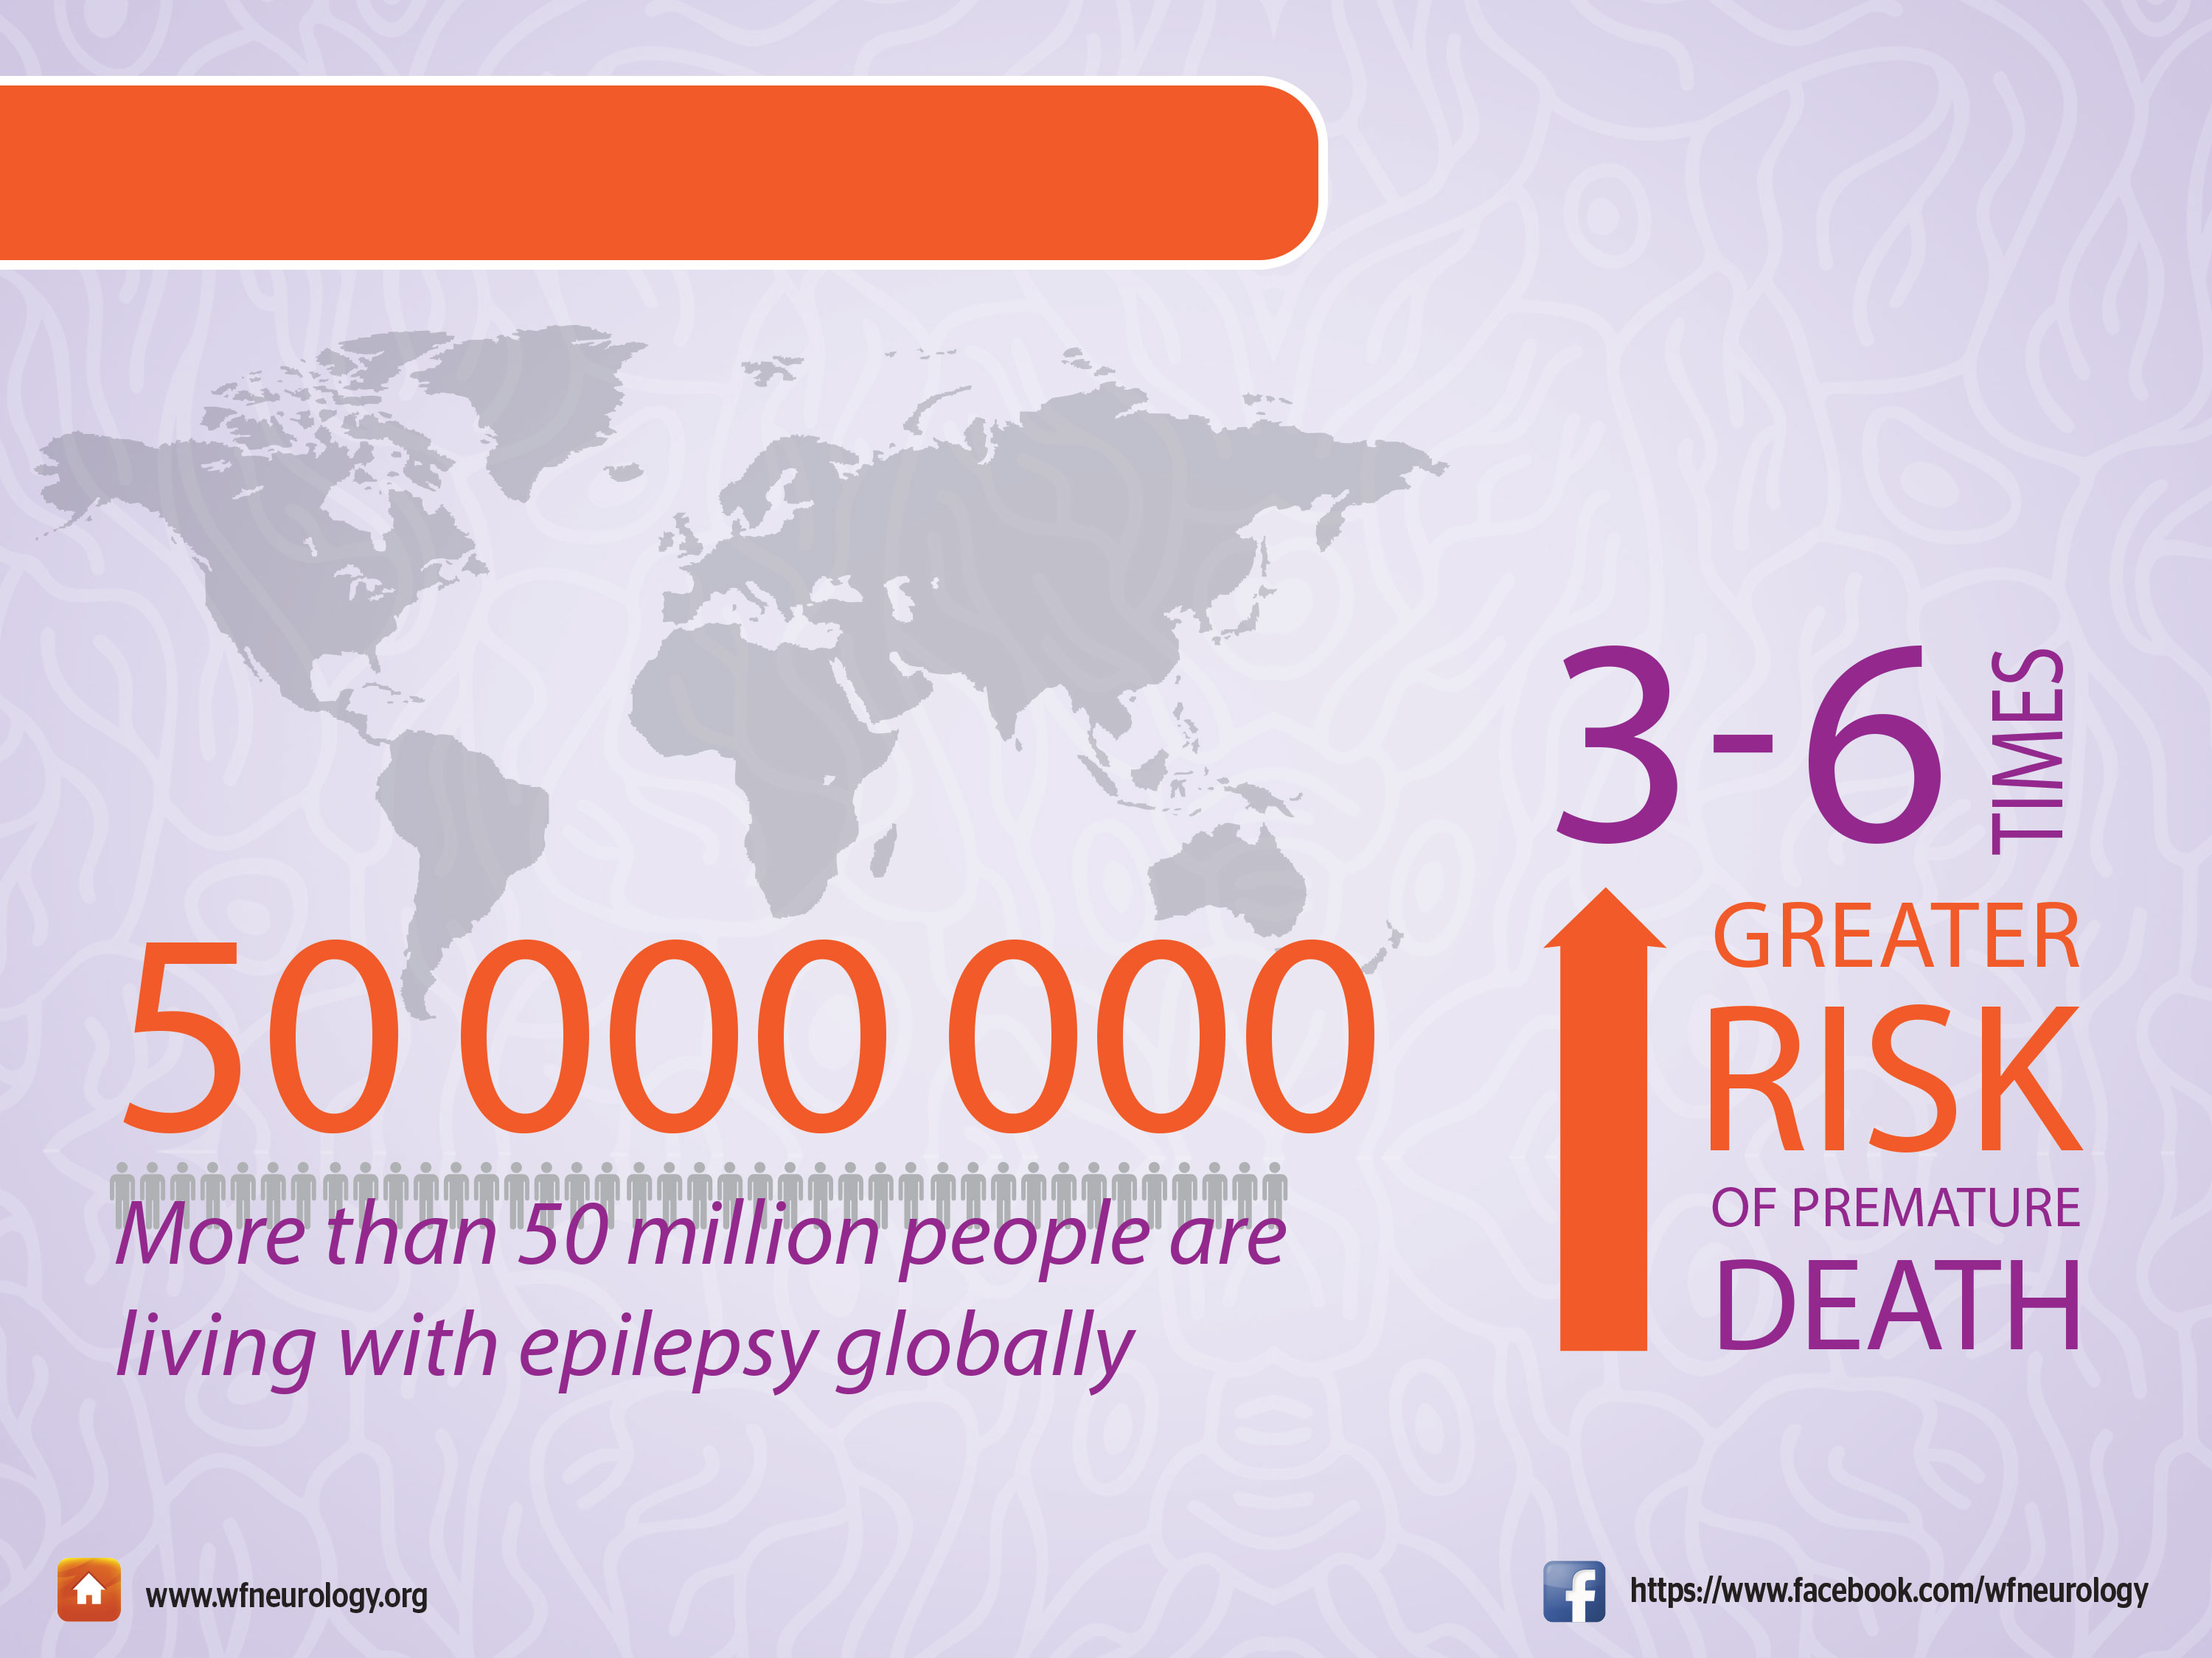
What is the IMPACT of Epilepsy?

Slide 8
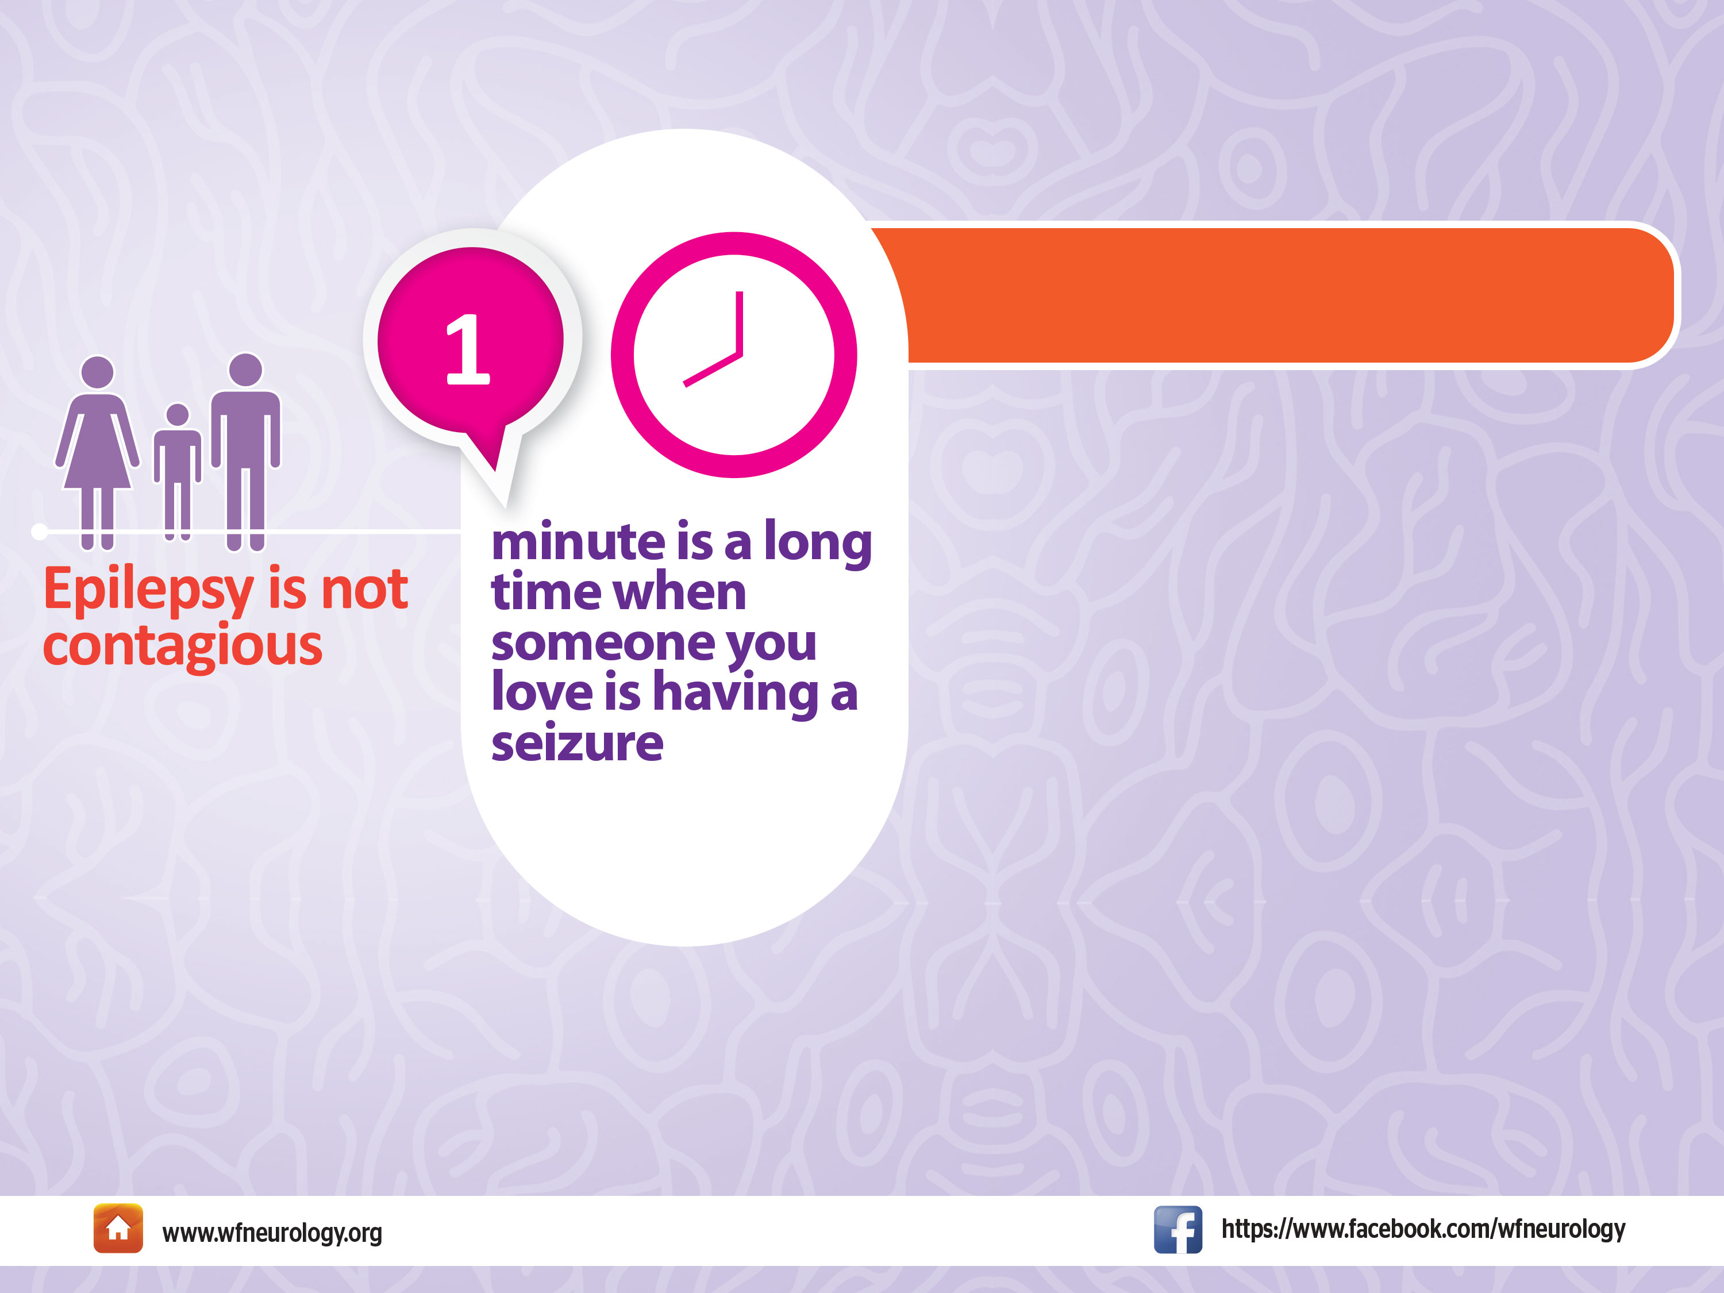
How Long Do Seizures Last ?
The type of seizure depends on which area of the brain is involved.
A person having a seizure may experience an alteration in behavior, consciousness, movement, perception and/or sensation.

Slide 9

Focal Seizures
Generalized Seizures
Types of Seizures
Focal seizures begin in one place in the brain, called the seizure focus, and may be discretely localized or more widely distributed. For each seizure type, onset is consistent from one seizure to another, with preferential patterns of spread. Focal seizures may or may not alter awareness.
In generalized seizures, abnormal electrical activity occurs throughout the whole brain (both hemispheres).
Generalized seizures alter awareness. They can be convulsive or non- convulsive.

Slide 10
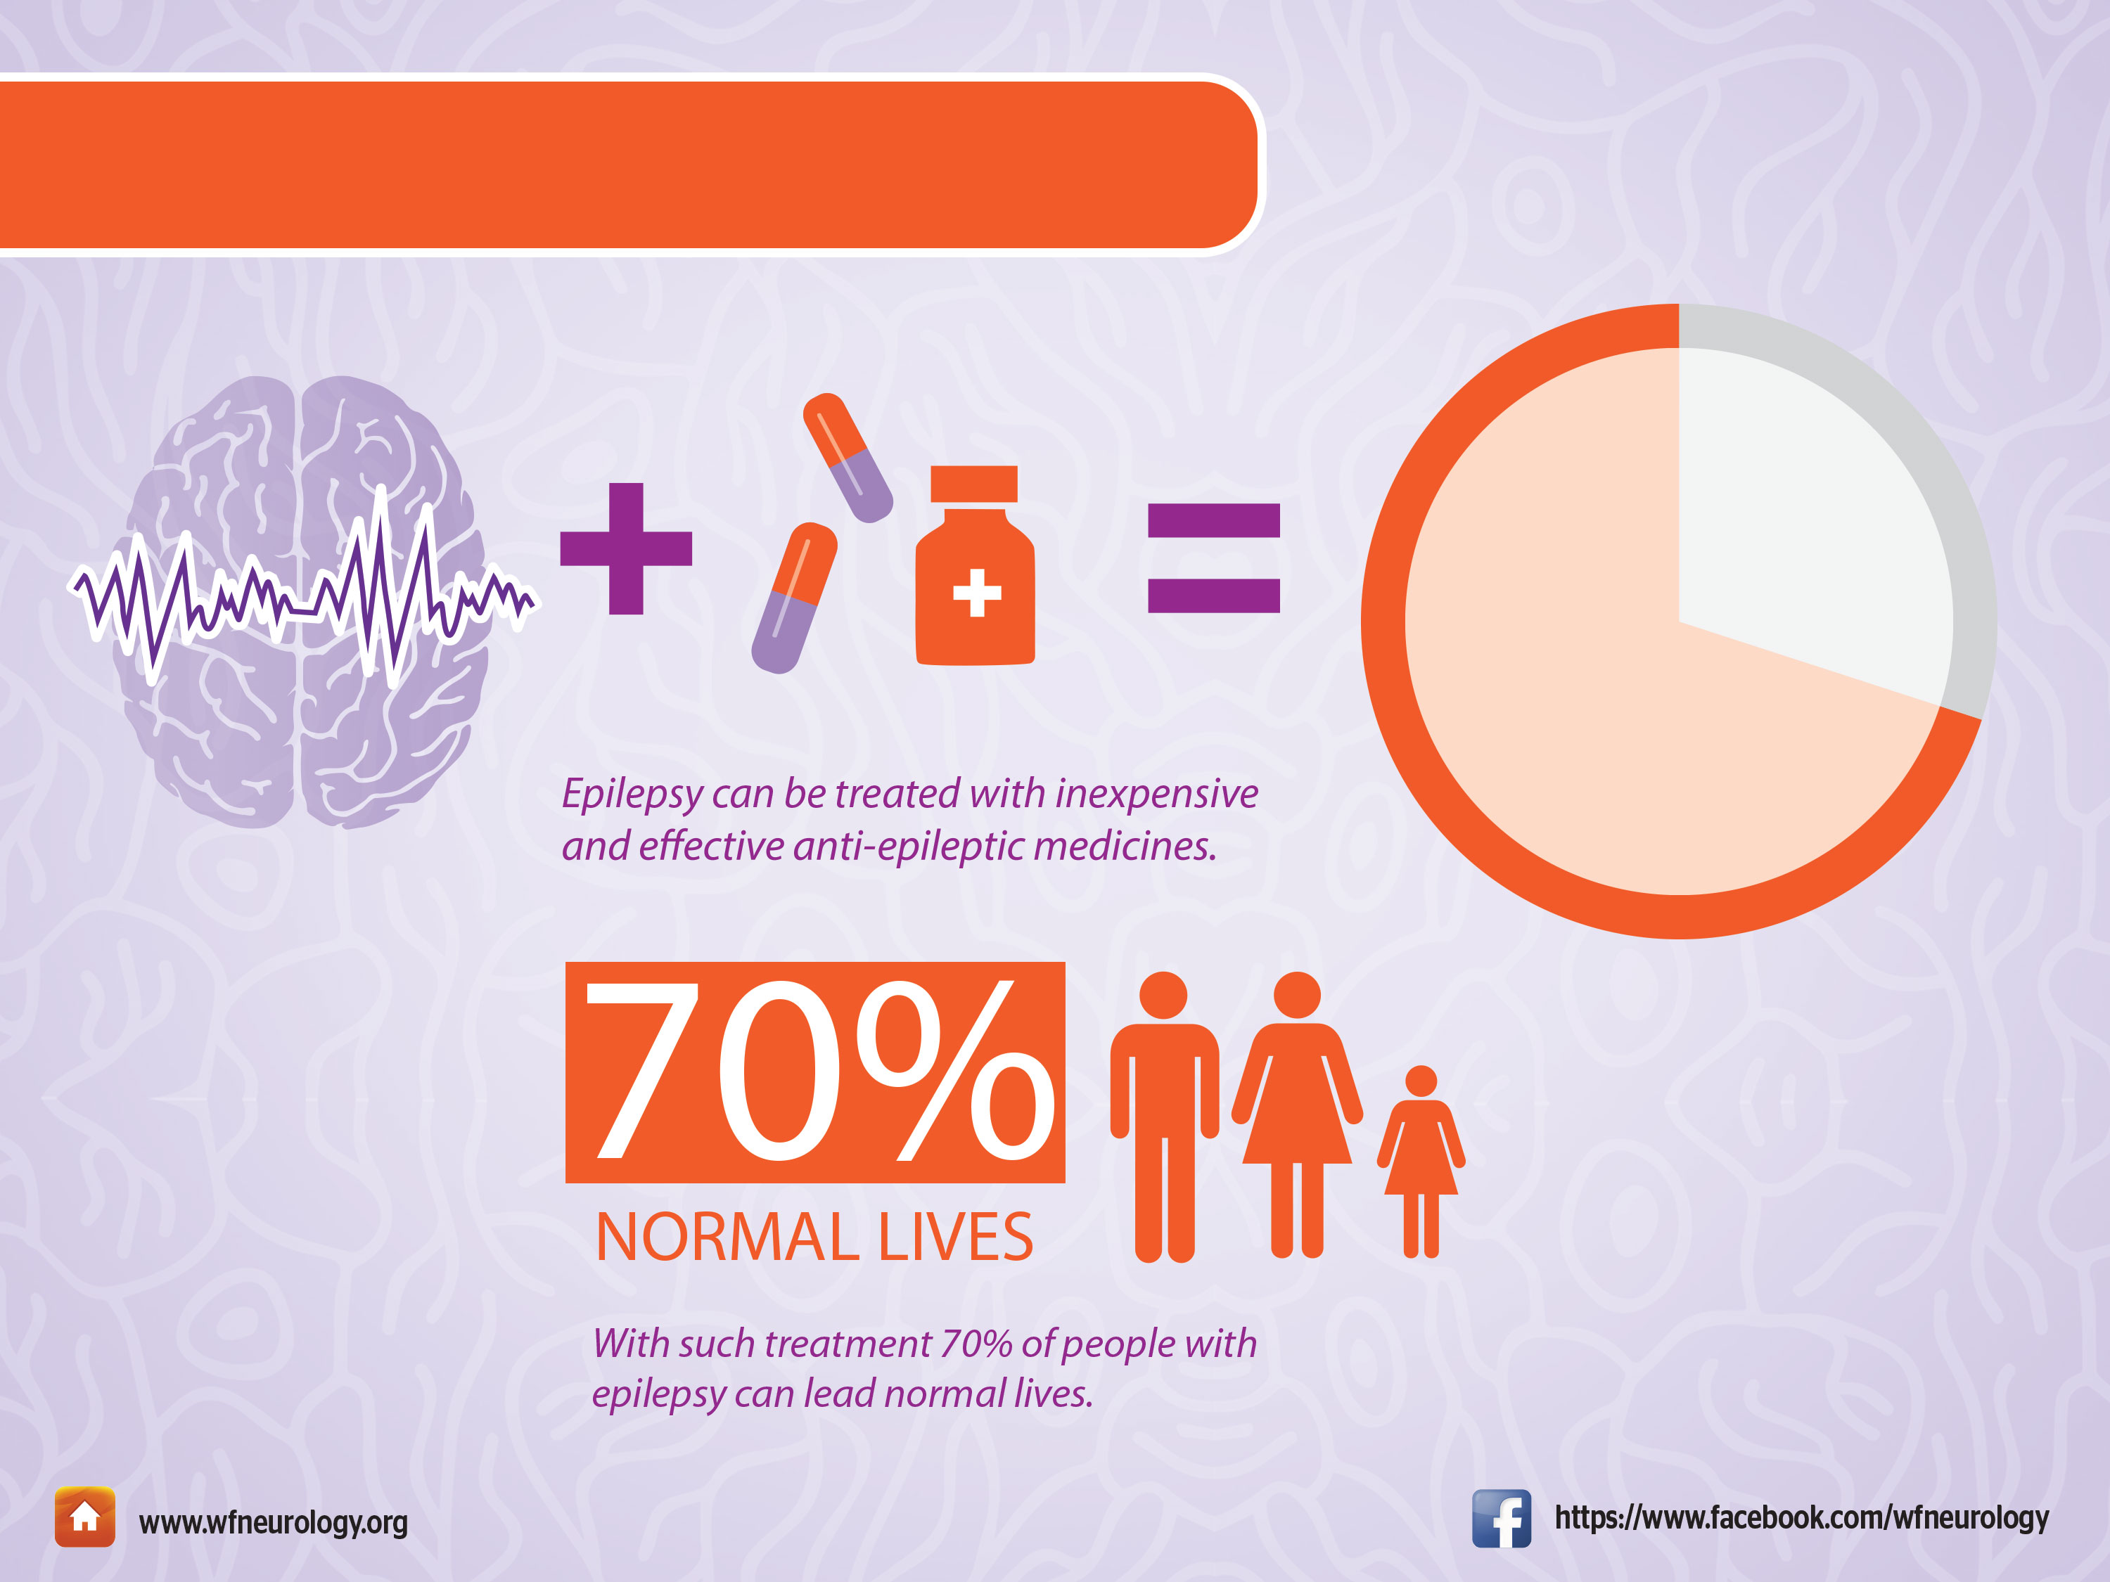
What is the Solution?

Slide 11
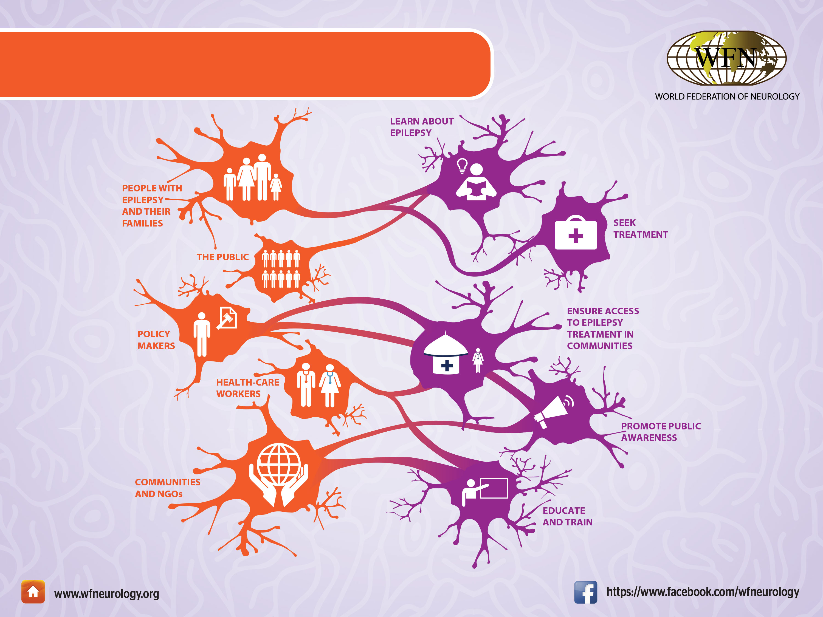
Who Can Do What?

Slide 12
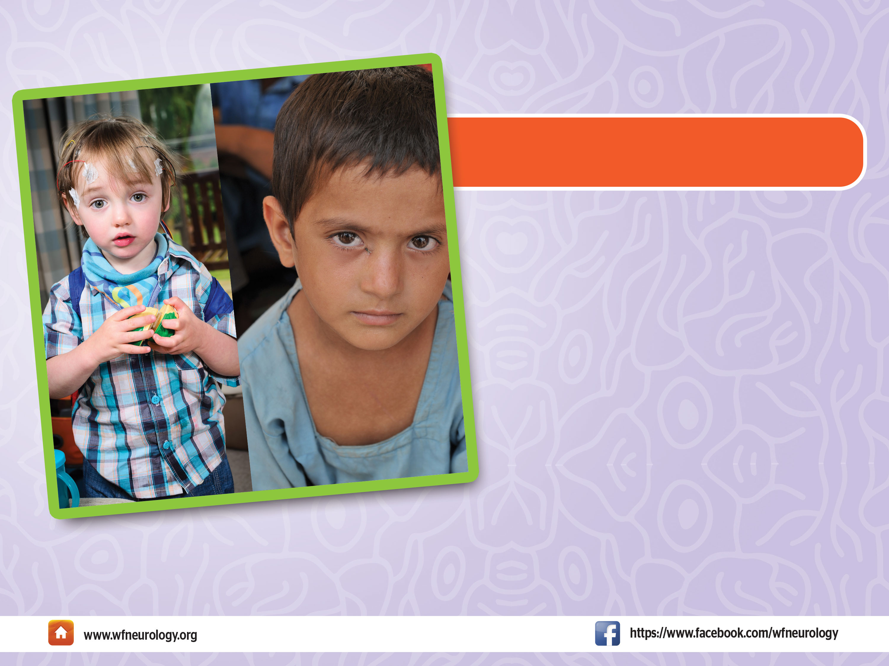
Don’t Hide Epilepsy!
Epilepsy has never received
the support that is
commensurate to its costs,
in part because many work
hard to hide it out of fear from repercussions. Most societies
have widespread, unfounded prejudices against people with
epilepsy.

Slide 13

Epilepsy Can Kill
The burden of the disease is further emphasized by the greatly increased death rate among people with epilepsy from seizure-related accidents, much increased depression and suicide rates, as well as the disease itself.
2nd Unexpected Cause of Death!
Just in terms of life-years lost from sudden unexpected death, epilepsy ranks second only to stroke among major neurological diseases.

Slide 14
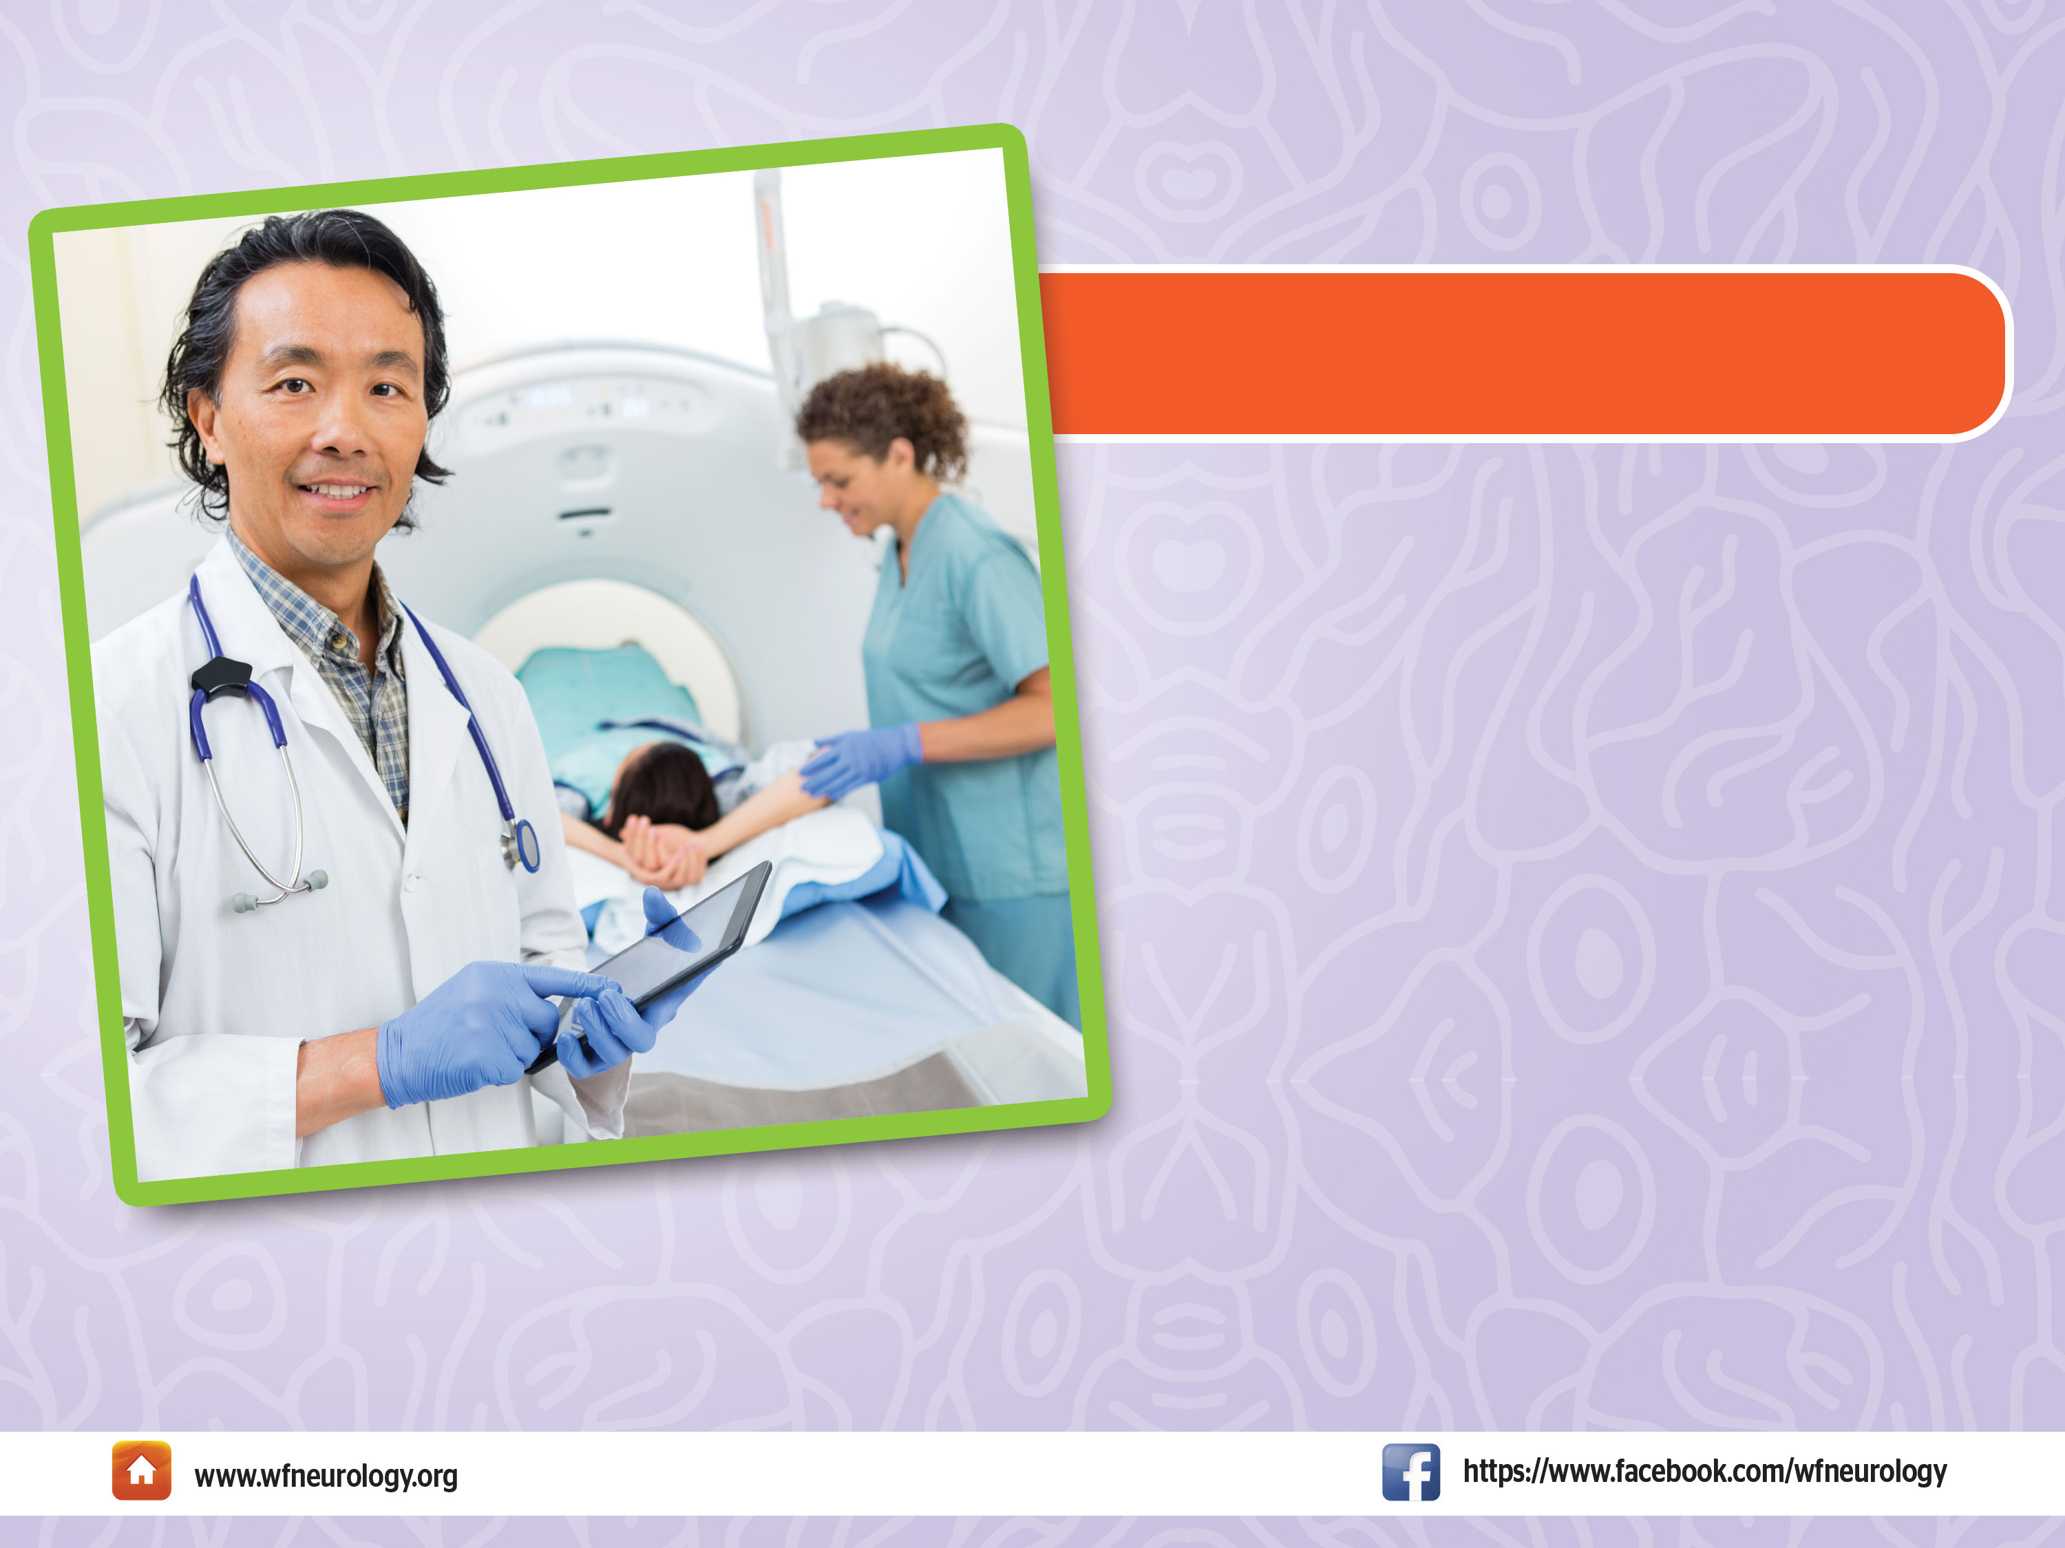
What Can treatment Do?
With treatment, 70% of people with epilepsy could be seizure free and live normally.

Slide 15

Training of Physicians
Many health care providers do not
have the training to recognize,
diagnose or treat epilepsy.
Every medical student should be
sensitized to epilepsy in their early
training.

Slide 16

Research & Legislation
Research and legislation is needed to improve access to care and the quality of
life of persons with epilepsy.

Slide 17
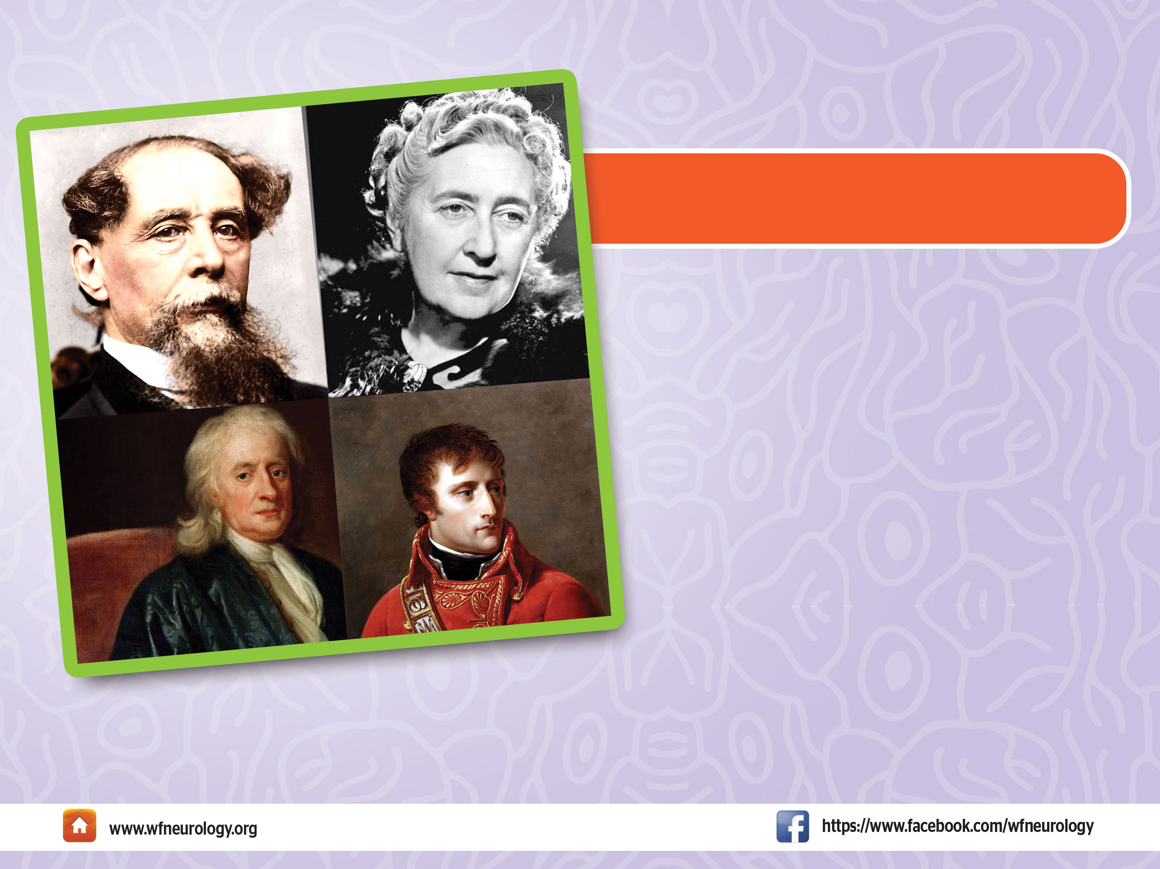
Most Exceptional & Talented
People with Epilepsy
Some of the most exceptionally
creative and talented people in
history had epilepsy, including:
St. Paul, Julius Caesar, Dante,
Joan of Arc, Isaac Newton, Molière, Napoleon Bonaparte, Handel, Beethoven, Flaubert, Paganini, Tennyson, Byron, Charles Dickens,
Fyodor Dostoyevsky, Vincent Van
Gogh, Lewis Carroll ,Alfred Nobel, Agatha Christie, and Richard Burton.

Slide 18

Together We Can!
Put local Society Logo here
Use this World Brain Day to bring greater visibility to this neglected disease.
National health care and research agendas need to recognize the seriousness
of epilepsy and its consequences.
Address the great social, medical and economic burdens of epilepsy.
Remember that epilepsy is a treatable brain disease.

